Slide 1


Money
Guard
Cyber Theft & Anomaly Detection in Multi-Bank Transactions

Slide 2

Index
02
04
Problem Statement
Our Solution
How? What? Why?
What we have developed to be a candidate for the final last solution
01
03
Introduction
Existing Solutions
& their Limitations
A quick overview about the
Problem statement
Already launched previous solutions and how they are not the final solution.

Slide 3
06
08
Key Features & Benefits
Data Collection & Preprocessing
The real time fraud & anomaly detection by analyzing the bank transitions
Collects the data from the bank transactions and performs the data cleaning
05
07
How it works
Technology Stack
It detects the fraud through step-by-step flow And generates the alerts.
Machine learning & artificial intelligence
Python and scikit-learn.

Slide 4
10
12
Live Demo / Screenshots
Summary & Key Takeaways
Live demo of the prototype or running model.
How are system improves the fraud detection
09
11
AI Model & Algorithm
Real-World Applications
Uses supervised or unsupervised learning and applies the decision tree algorithm for anomaly detection
In banking and financial institutions
Ecommerce and fraud preventions

Slide 5

Introduction
In today's digital era, financial transactions are increasingly conducted online, making banking systems prime targets for cyber theft and fraudulent activities. Cybercriminals exploit vulnerabilities in multi-bank transactions, leading to unauthorized fund transfers, identity theft, and large-scale financial fraud. To combat this, AI-powered anomaly detection systems are revolutionizing banking security. By leveraging machine learning (ML) and big data analytics, these systems can identify unusual transaction patterns in real time, flagging suspicious activities before financial losses occur. This approach enhances security, reduces false positives, and ensures safer transactions across multiple banks.
Our project focuses on developing an AI-driven fraud detection system that analyzes multi-bank transactions, detects anomalies, and prevents cyber theft effectively.
es rather than evolving attack patterns.
To combat this, AI-powered anomaly detection systems are revolutionizing banking security. By leveraging machine learning (ML) and big data analytics, these systems can identify unusual transaction patterns in real time, flagging suspicious activities before financial losses occur. This approach enhances security, reduces false positives, and ensures safer transactions across multiple banks.
Our project focuses on developing an AI-driven fraud detection system that analyzes multi-bank transactions, detects anomalies, and prevents cyber theft effectively.

Slide 6
jgjjgjhkjk
Problem Statement(
How?
Weak Security Infrastructure
Sophisticated Cyber Attacks
Insider Threats & Human Errors
Lack of Real-Time Fraud Detection
Why?
Cyber theft occurs due to security vulnerabilities, human errors, and evolving cyber threats that exploit banking systems. Anomaly detection happens as a preventive measure to identify unusual transaction patterns and detect fraud in real time.
What?
Cyber theft involves the unauthorized access or theft of financial data, while anomaly detection is an AI-driven technique that identifies unusual transactions to prevent such fraud and cyber threats.

Slide 7
Existing solutions and their limitations
Limitations:
Expensive and mainly focused on endpoint security, not directly designed for financial fraud detection.
May struggle with real-time financial fraud detection and lacks comprehensive AI-driven anomaly detection for multi-bank transactions.
Requires high computational power, and detection accuracy may drop for newly emerging fraud tactics.
Existing Solutions
​To combat cyber theft and detect anomalies in multi-bank transactions, several advanced tools and platforms are available. Here are some notable solutions:
1.Feedzai.
2.HighRadius Anomaly Management Software
3.CrowdStrike Falcon
4.Deep Instinct
5.McAfee MVision Cloud
These tools leverage advanced technologies such as artificial intelligence and machine learning to enhance the detection and prevention of fraudulent activities in financial transactions.

Slide 8
n
Our Solution
Compared other available options out product based on being simple to use for any one either he’s an expert or a compete rookie in technical knowledge.
Our project offers a quick scan over transactions withnml model trained over by thousands of dataset.
Our project would’nt be much higher power hungryin comparison to other .
.
.

Slide 9

How it works
Data Collection: The system collects transactional data from bank servers, financial APIs, and customer databases, data includes Transaction Amount, Time, and LocationDevice and IP Address InformationUser Behavior & Account History.
Data Preprocessing: To improve accuracy, data is cleaned, normalized, and structured by:Handling Missing ValuesRemoving Duplicates & OutliersEncoding Categorical Features (e.g., Transaction Type: Credit/Debit)
Anomaly Detection Using AI/ML The system applies Machine Learning algorithms to detect suspicious activities:
Supervised Learning (Fraud Detection) Regression.
Unsupervised Learning (Anomaly Detection)
4. Real-Time Monitoring & Pattern Analysis :The system continuously monitors transactions, analyzing user behavior and comparing it with historical data. If an unusual pattern is detected (e.g., a sudden large withdrawal from a new location), it flags the transaction as suspicious.
5. Risk Scoring & Alerts: Each transaction is assigned a risk score based on predefined rules and ML predictions. If the score exceeds a set threshold, the system:Blocks the transaction or requests additional verification (OTP, biometric authentication).Sends alerts to banks, users, or cybersecurity teams.
6. Post-Detection Action & Fraud Prevention: If fraud is confirmed, the system blacklists fraudulent accounts.Adaptive Learning helps improve detection accuracy by continuously updating ML models.
.
Recruit and train qualified staff to support new market operations. Address potential skills gaps and ensure cultural competency within the team.
.

Slide 10
hjh
Technology Stack
Frontend(user interface):
->
Backend(Server & Business Logic):
->
AI/ML for Anomaly Detection & Cybersecurity:
->
Decision Tree ALGO
HTML
Python

Slide 11
Data Collection & Preprocessing
1.Data collection:
From open sources such as Kaggle , Google Dataset Search, IEEE Dataport.
2.Data Cleaning & Preprocessing:
Step 1: Data Cleaning-> Handle Missing Values ,Remove Duplicates,🔹 Outlier Detection & Removal.
Step 2: Data Transformation-> Feature Encoding ,Scaling & Normalization
Step 3: Feature Engineering-> Transaction-Based Features, User Behavior Features, Fraud Indicators.
Step 4: Splitting DataTrain-Test Split (80-20%), Cross-Validation (K-Fold).
3. Data Preprocessing Pipeline
4. Storing Preprocessed Data:
Once data is cleaned and transformed, it needs to be stored securely

Slide 12
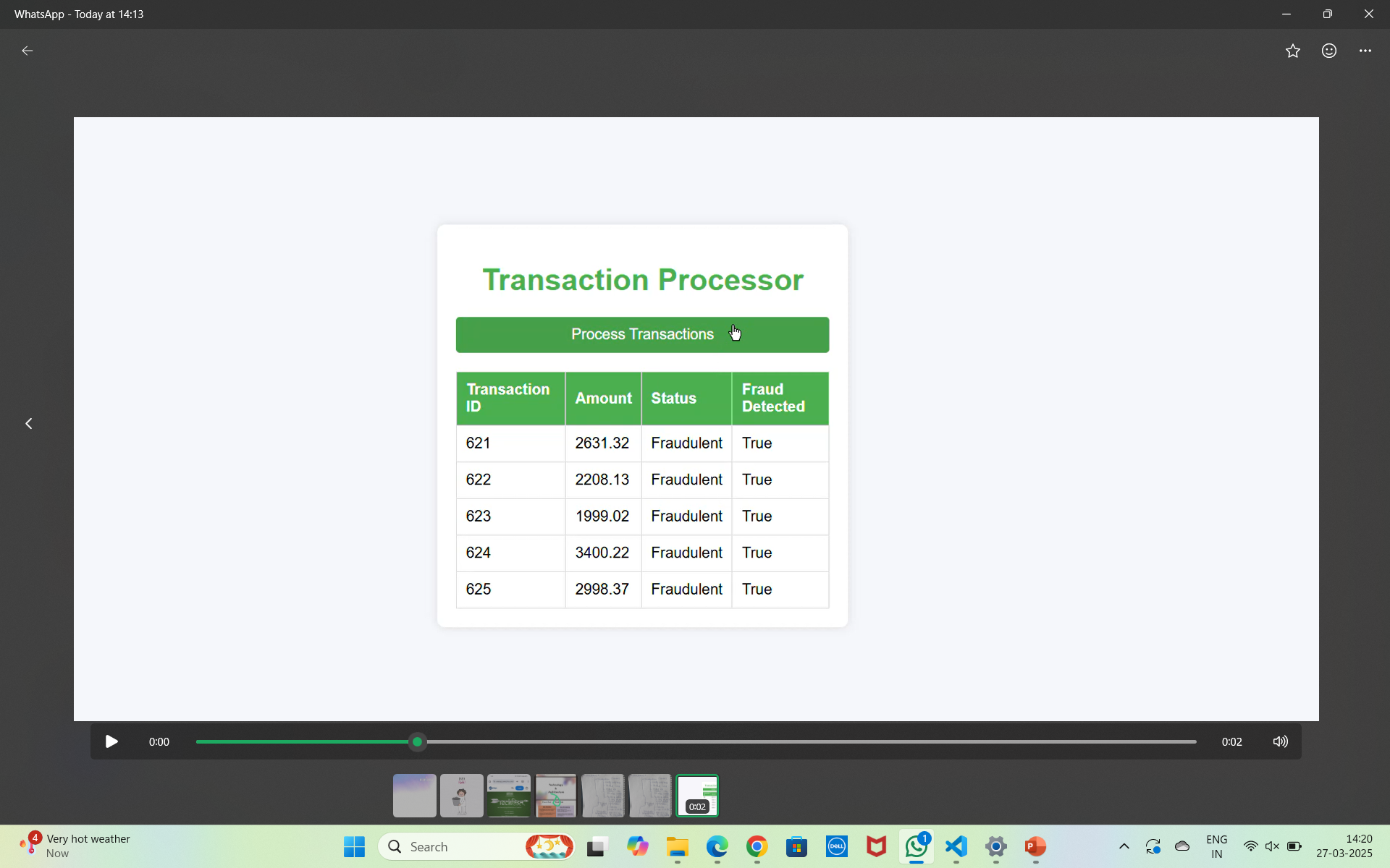
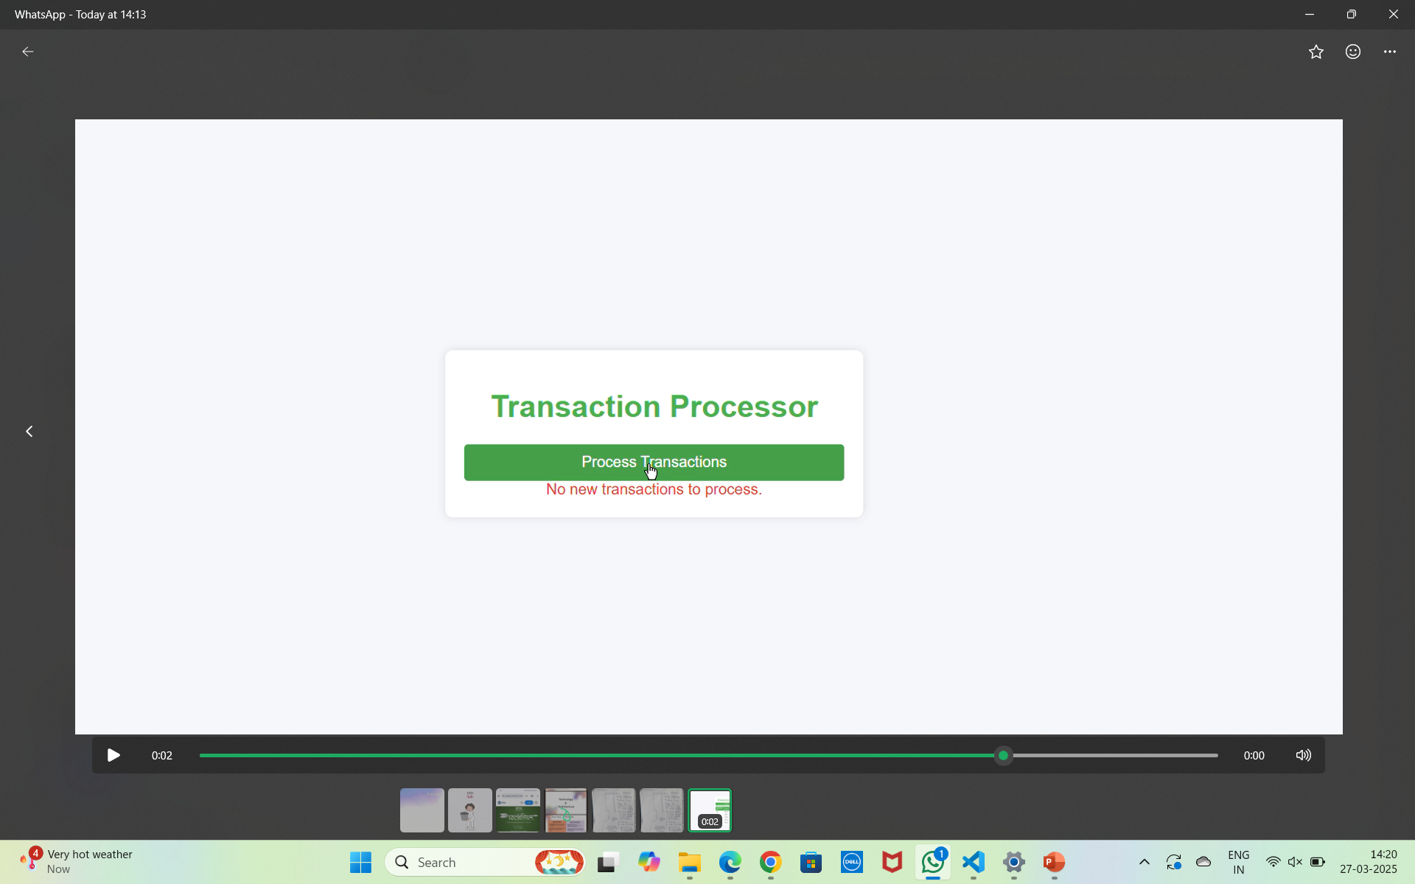
Live Demo / Screenshots

Slide 13
Real-World Applications
Cyber theft and anomaly detection systems are widely used in various industries to prevent fraud, detect suspicious activities, and enhance security. Below are some key real-world applications:
Banking & Financial Services: Fraud Detection in Transactions, Credit Card Fraud Prevention, Insider Threat Detection.
E-Commerce & Digital Payments: Preventing Payment Fraud, Account Takeover Prevention.
Cybersecurity & IT Infrastructure: Intrusion Detection Systems (IDS), Phishing & Malware Detection,
Ransomware Prevention.
4. Stock Market & Trading Platforms: Insider Trading Detection, High-Frequency Trading Anomaly Detection.
5.Government & National Security: Cyber Espionage & Terrorism Prevention, Money Laundering & Financial Crimes.
6. Healthcare & Insurance: Medical Billing Fraud Detection, Electronic Health Record (EHR) Security.
7.Telecom & Mobile Networks: SIM Swap Fraud Detection, Spam & Scam Call Prevention.

Slide 14
Summary & Key Takeaways
Cyber theft involves financial fraud, data breaches, and unauthorized transactions, making anomaly detection essential for identifying suspicious activities in multi-bank systems. It occurs due to weak security, phishing attacks, insider threats, and evolving hacking techniques. Existing AI-based solutions like Feedzai, CrowdStrike, and McAfee help detect fraud but face limitations such as false positives, high costs, and adaptability issues.Developing an effective detection system requires technologies like React.js, Python (Flask/Django), PostgreSQL, MongoDB, and AI/ML tools (TensorFlow, Scikit-learn), along with security measures like SSL encryption, firewalls, and blockchain. Data collection from sources like Kaggle and OpenBanking APIs, followed by preprocessing (cleaning, feature engineering, and normalization), ensures accurate fraud detection.These systems have real-world applications in banking, e-commerce, cybersecurity, stock markets, healthcare, and telecom to prevent fraud and unauthorized access. Despite challenges like false positives and regulatory concerns, AI-driven anomaly detection is crucial in safeguarding financial transactions against evolving cyber threats.

